Slide 1
Good Morning!
Today’s Agenda:
Collect $ and signed syllabi
CREEK WEEK!!
Review Characteristics from last class
Characteristics of Life Notes
Review
Mnemonic Creation Activity
Please bring a binder/folder and tabs for NEXT CLASS!!!

Slide 2
Characteristics of life!
https://prezi.com/fbin2dgz7llg/characteristics-of-life-with-videos/#_=_

Slide 3
Characteristics of Life
Made of Cells
Living things are organized.
They show an orderly structure.
Universal genetic code
All living things are made of cells that contain DNA!!!
This is where organisms store the information they need to live, grow and reproduce.

Slide 4
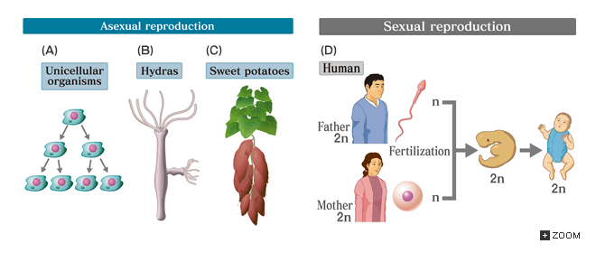
3. Reproduction
Living things reproduce.
Making offspring is essential to the survival of a species

Slide 5
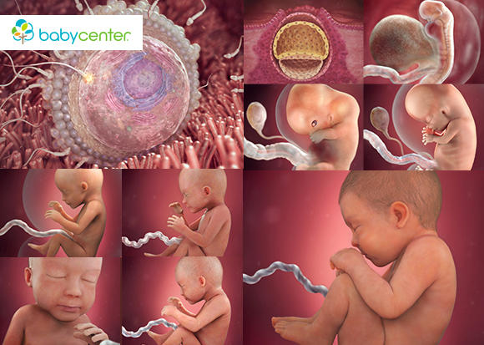
4. Growth and Development
Living things grow
Increase the amount of living material and form new structures
Living things develop
All the changes in the life of an organism

Slide 6
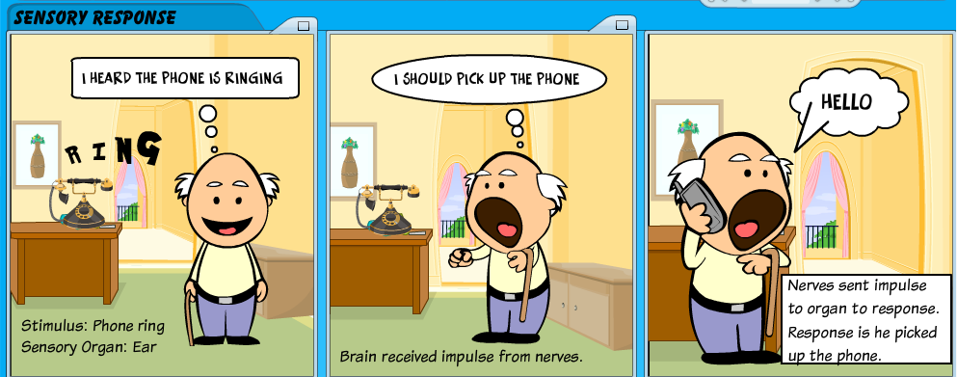
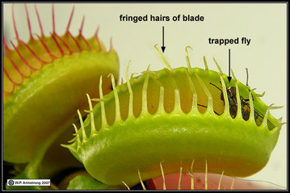
5. Response to Stimuli/environment
Living things adjust to their environment – air, temperature, other living things, etc.
Ex: Deciduous trees lose their leaves in the cold
Stimulus = a condition that an organism must adjust to
Response = a reaction to a stimulus

Slide 7
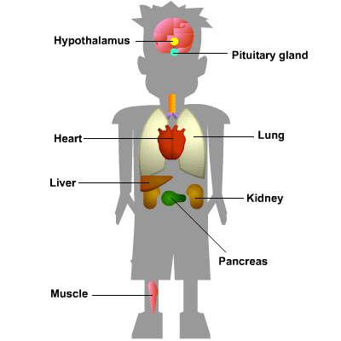
6. Maintain Homeostasis
Regulate and maintain an internal balance
Why? They need an internal environment suitable for survival.
To do this, they respond to internal changes.

Slide 8
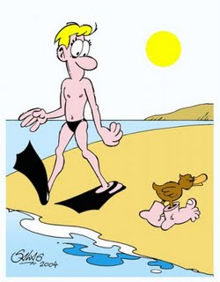
7. Adapt
Adaptation = a structure, behavior, or internal process that helps organisms survive
Evolution = the gradual accumulation of adaptations
8. Use materials and Energy
All organisms must take in materials and energy to grow and develop and reproduce.

Slide 9
Now, let’s look back at all the species from last class!

Slide 10
Characteristics Mnemonic Creation

Slide 11
Brainstorm
With your partner jot down as many things as you know about bacteria and viruses

Slide 12
Bacteria vs. Virus
https://www.youtube.com/watch?v=s-HThHRV4uo
Virus
Bacteria

Slide 13
What do you think?
https://www.youtube.com/watch?v=JUlGN5XJ5dc

Slide 14
ZIKA Virus
https://www.youtube.com/watch?v=aM3vhZrNa7E

Slide 15
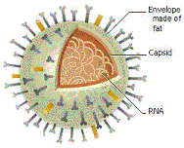
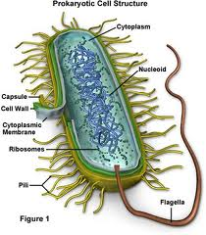
Bacteria
Virus
Enclosed by a cell wall
Contains cytoplasm and hereditary material of the cell
Ribsomes are the only organelle found in the cytoplasm
DNA or RNA (retrovirus)
Surrounded by protective protein coat (capsid)
Genetic material carries information for multiplication
Hijacks biochemical machinery of host cell to carry these processes out

Slide 16
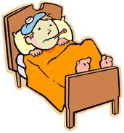
Infectious disease can be spread through:
1. contact with an infected person
ex: Influenza (V)
2. contact with a contaminated object
ex: Influenza (V)
3. contact with an infected animal
ex: Lyme Disease (B): Bite from infected tick contact with an environmental source.

Slide 17
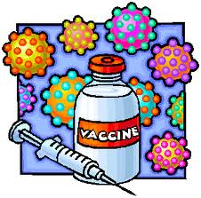
Diseases Caused by Viruses
Cause disease by either damaging or killing cells
First attaches itself to a healthy cell and then injects its DNA or RNA into cell
Then replicates once inside infected cell
No Cure, just prevention with vaccine.
Vaccines: a substance introduced into the body to stimulate the production of chemicals that destroy specific viruses or bacteria..

Slide 18
Diseases Caused by Viruses
Rabies
Influenza
West Nile Virus
Viral Meningitis
Polio
Common Cold
AIDS/HIV
Chicken Pox
Small Pox
Yellow Fever *
Ebola
SARS

Slide 19
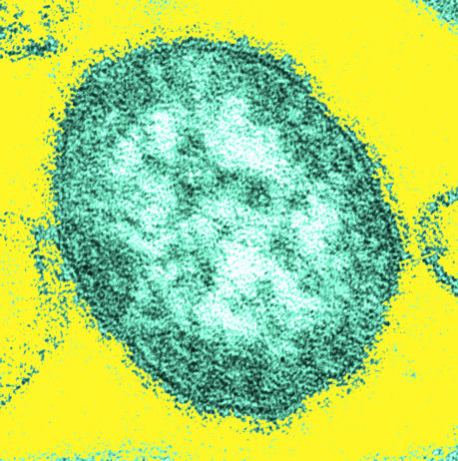
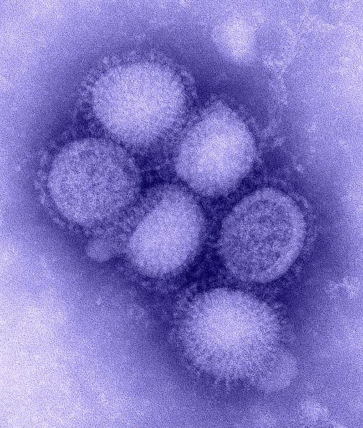
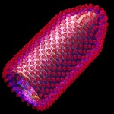
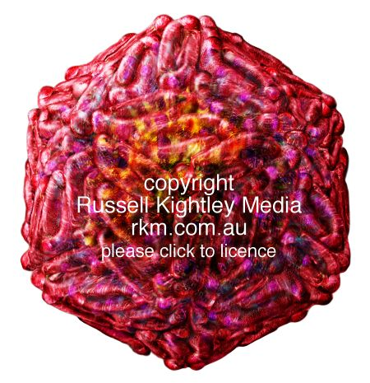
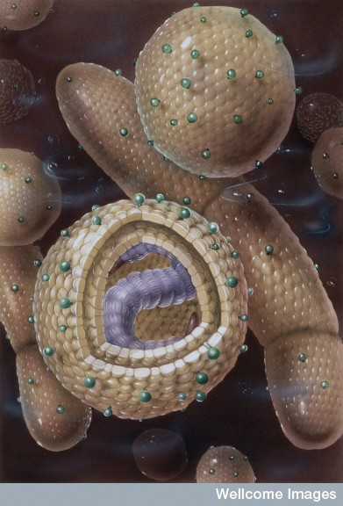
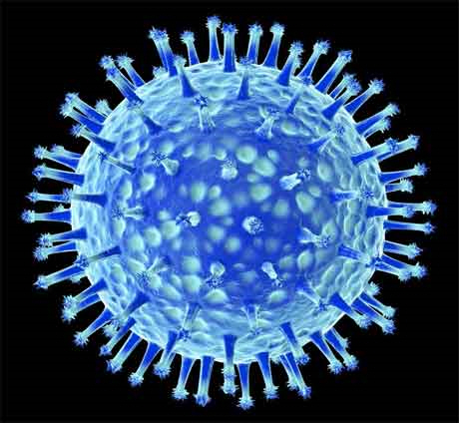
Measles
Rabies
Hepatitis
H1N1: Swine Flu
West Nile Virus
H5N1: Avian Flu

Slide 20
Diseases Caused by Bacteria
Use antibiotics to cure bacterial infections
Antibiotics or a chemical that can kill bacteria without harming a person’s cell
Bacteria can develop a resistance to antibiotic and will no longer kill
This is what happens when you do not take medicine completely
Anthrax
Lyme Disease
Leprosy
Bacterial Meningitis
Strep Throat
Tuberculosis

Slide 21
Virus vs. Bacteria
Systemic means it's in the blood stream and is spreading/has spread through the body
Localized means the infection is restricted to one small area only. An infected cut or ulcer is an example of this.
Bacteria and Viruses Comparison
 | Bacteria | Virus
Nucleus | No | No, they have no cells
Reproduction | Fission, conjugation & spore formation | Dependent on host cell machinery
Can cause disease? | Yes | Yes
Structures | DNA & RNA float in the cytoplasm, surrounded by cell membrane & wall | DNA or RNA enclosed within a protein coat (capsid)
Living Attributes | Living organism | Non-living
Infection | Localized | Systemic
Beneficial | Some (photosynthesis, vitamin production, nitrogen fixation) | Not beneficial
How treated? | Antibiotics | Antivirals slow & vaccines prevent
# of cells | Unicellular | Non-living — no cells

Slide 22
Hunting the Nightmare Bacteria
http://www.pbs.org/wgbh/pages/frontline/hunting-the-nightmare-bacteria/
Name the 3 diseases contracted
For each provide:
Characteristics of infection
Cure?
How was it contracted?
Overall question to answer: What is the problem with antibiotics?

