Slide 1
Part 2

Slide 2
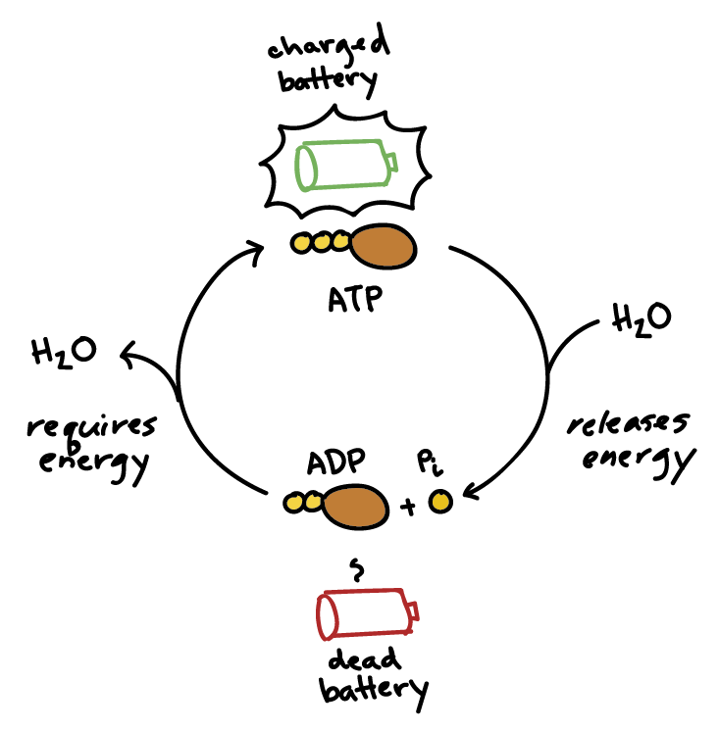
How is energy released in cells?
Molecules such as glucose or fat contain a large amount of chemical energy and are used to make a large number of molecules that have smaller amounts of energy.
This is done through cellular respiration which converts it into a phosphate bond on adenosine triphosphate (ATP)

Slide 3
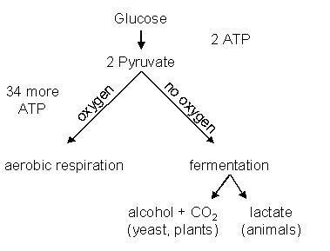
If oxygen is used, the process is aerobic respiration
If oxygen is not available, the process of anaerobic respiration is used, but it produces much less ATP because it can not fully break down the glucose.
This is why alcohol can burn – energy remains in the molecules.

Slide 5
What is energy needed for in cells?
Energy is used to transform small molecules into larger molecules such as protein and DNA (anabolic reactions)
Energy is used to transform larger molecules into smaller molecules (catabolic reactions)
Provides energy to pump ions and other particles across cell membranes from a lower to a higher concentration (active transport)
Chemical energy is converted to kinetic energy for movement of cell components and entire cell.
Chemical reactions for bioluminescent species to make part of the body flash or glow.

Slide 6
How is thermal energy generated and lost in living organisms?
Whenever energy changes form inside cells some is changed into thermal energy.
The energy change causes particles to move more rapidly so their temperature rises.
Chemical reactions can also release heat.
Why do we get hot when we run?

Slide 7
Why do we got hot when we run?
Chemical energy in glucose generates kinetic energy and some of the chemical energy changes to heat in our muscles.
Generation of thermal energy in organisms makes
them hotter than surroundings and heat is transferred
to the environment.

