Slide 1
Part 3

Slide 2
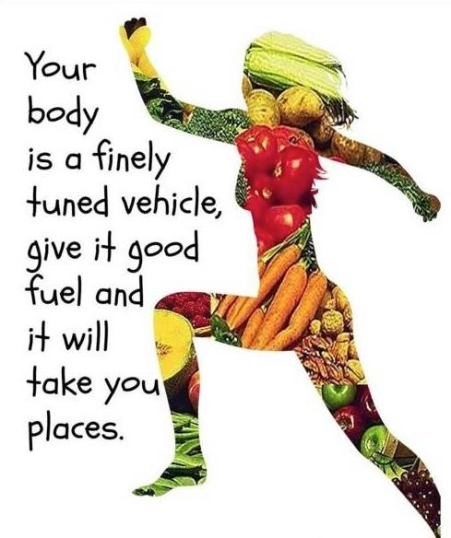
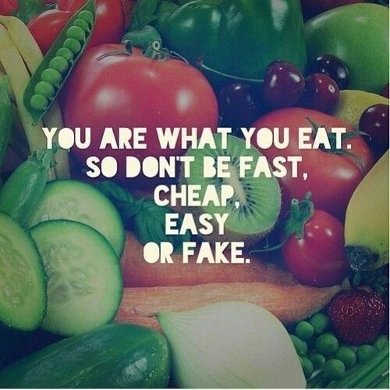

How do animals obtain energy?
Animals obtain energy by consuming other organisms.
Each cell is supplied with substances produced by digesting consumed organisms to release chemical energy such as from fats and carbohydrates.

Slide 3
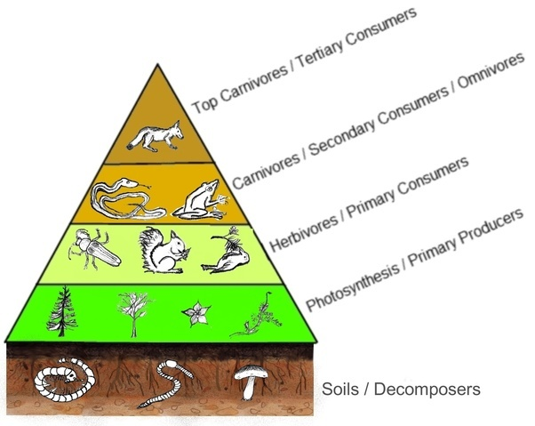
We can divide animals into categories based on what they consume.
Autotrophs produce their own food.
Heterotrophs consume other organisms for their food.
Decomposers release materials back into environment.

Slide 4
How does energy enter and leave ecosystems?
An ecosystem is composed of all of the organisms in an area together with their non-living (abiotic) components.
A system is a set of interacting components.
Open systems – resources can enter and exit. Including chemical substances and energy.
Closed systems – energy can enter and exit, but chemical resources cannot be removed or replaced.

Slide 5
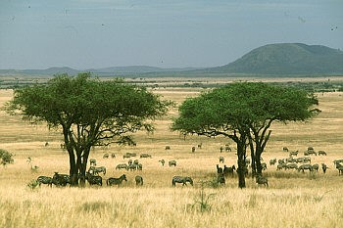
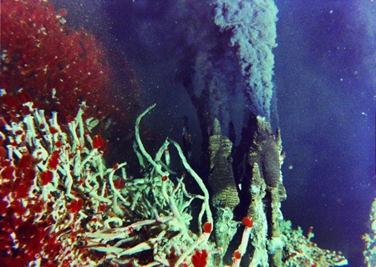
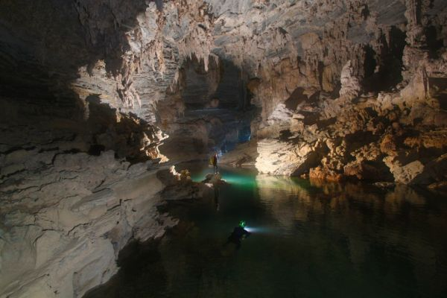
Most ecosystems are open systems with substances entering and leaving.
Energy within an ecosystem will decrease from use and loss as heat and must be replaced with energy entering the ecosystem or the ecosystem will die.
This could be from sunlight or dead organic matter.
Where is the energy from? What type of energy is it?
What type of system is it?

Slide 6
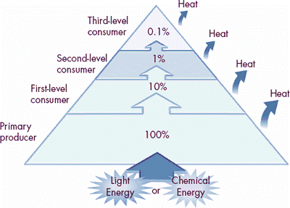
What prevents long food chains from developing?
A food chain shows how each living thing obtains food, and how nutrients and energy are passed.
Food chains rarely extend beyond tertiary consumers because so much of the original energy is lost as heat.
The 10% Rule: when energy is passed in an ecosystem from one trophic level to the next, only ten percent of the energy will be passed on.

