Slide 1
Plant Parts and Reproduction

Slide 2
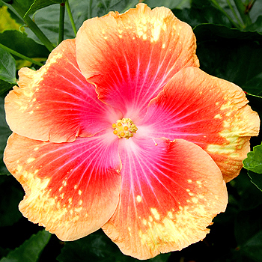
BellRinger
Agenda:
-BellRinger
-Flower Parts Notes
-Flower Dissection/Coloring
Decide if the flower pictured is a monocot or dicot.
To what group of plants does the flower belong to?
Schedule:
8:25- 9:40 1st
9:45-11:00 2nd
11:05-12:50 3rd
12:55-2:10 4th
2:15-3:15 PEP RALLY

Slide 3
Plant Reproduction of Angiosperms

Slide 4
Goal:
Label and explain function of plant reproductive structures.
Explain process of plant reproduction

Slide 5
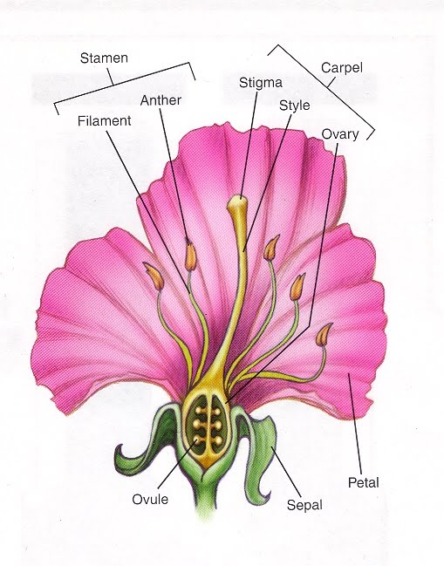
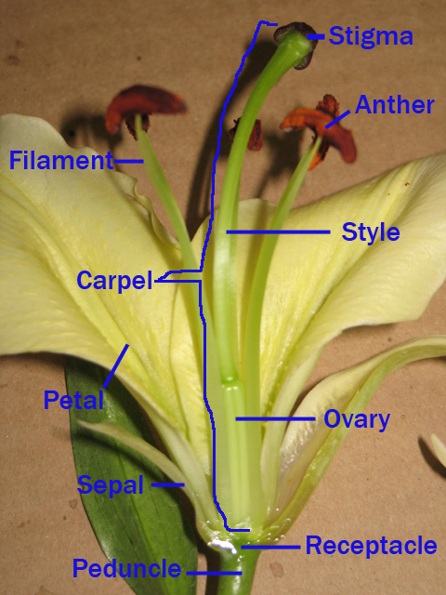
Structure of Typical Flower (Reproductive organ)

Slide 6
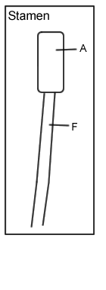
Role of Flower Parts
Petals: Attract insects and other pollinators to the flower. Often very colorful.
Sepal: enclose flower bud before it opens and protect flower as it develops.
“P.S.”
Male Parts
Anther: Located at top of filament (think “antlers”). Where pollen grains are produced. Pollen grains contain the male reproductive cells (i.e. sperm)
Filament: Long stalk that supports anther.
The Filament and Anther together make up the Stamen. (staMEN)
Anther
Filament

Slide 7
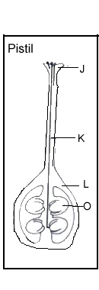
Role of Flower Parts
Female Parts
Stigma: Top of carpel. Sticky portion where pollen initially lands. “stigma sticks”
Style: The stalk of the carpel that contains the pollen tube through which pollen travels to ovary.
Ovary: Located at base of carpel. Where one or more ovules is located. Eventually matures into fruit after fertilization.
Ovule: Structure that contains female reproductive cells (i.e. eggs). Matures into seed when fertilized.
Stigma + Style + Ovary = Carpel (aka pistil) which is innermost part of flower.
“S.S.O.C.” (Top to bottom)
Stigma
Style
Ovary
Ovule

Slide 8
Structure of Typical Flower (Reproductive organ)

Slide 9
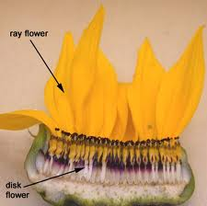
Other Flowering Plant Reproductive Structure Organizations!
Not all flowering plants have the “typical” flower structure…They vary enormously in structure!!!!
A tulip has only one carpel while a wild rose has several.
Flowers like sunflowers contain clusters of several individual flowers that are reproductive (called disk flowers).
Sunflower
Cross-section

Slide 10
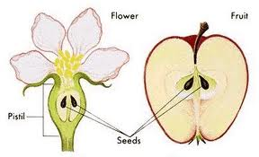
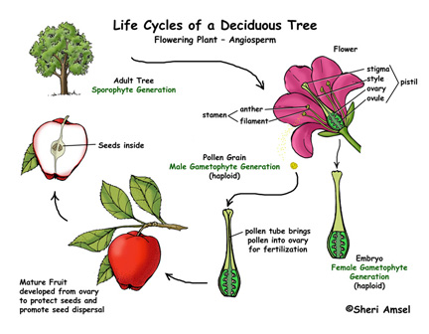
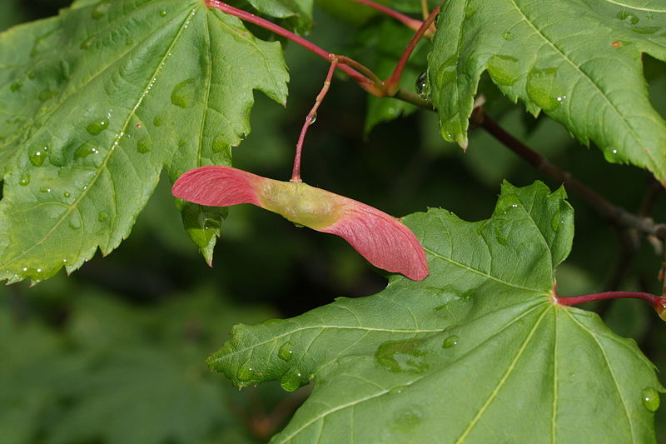
Flowering Plants Reproduction Cycle
Ovary
Not all fruits look the same….
Notes:
http://biology.clc.uc.edu/courses/bio106/angio.htm

Slide 11
Flowering Plants Reproduction Cycle
During the process of fertilization:
1) Pollen from anther lands on the stigma (How does it get there??? More on that in a second.)
2) A tube grows down the style and enters the ovary.
3) Male reproductive cells (pollen) travel down the tube and join with the ovule (egg), fertilizing it.
4) The fertilized ovule becomes the seed, and the ovary becomes the fruit.

Slide 12
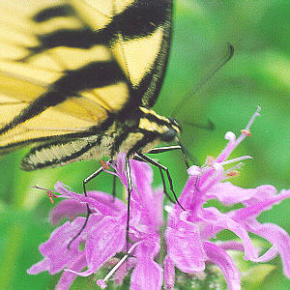
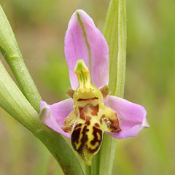
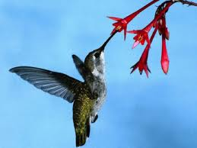
Why Flowers???
Why would plants put material and energy toward flowers???
Some flowers rely on wind to help with pollination (the transfer of pollen from the male to the female reproductive structures).
Flowers are able to attract organisms like insects, bats and birds to help with pollination.
Some flowers have gotten very good at this…
http://www.youtube.com/watch?v=-h8I3cqpgnA
Notes:
http://biology.clc.uc.edu/courses/bio303/coevolution.htm
http://www.biology4kids.com/files/plants_angiosperm.html

Slide 13
Why Fruits???
SEED SPREADING TACTIC NUMBER 1: BY ANIMAL EATING
The fruit surrounds and protects the seed.
Some fruits (the sweet and fleshy ones) can attract animals to eat the fruit.
The seeds pass through their digestive system unharmed and sprout in the feces eliminated from the animal.
Notes:
http://courses.bio.indiana.edu/L104-Bonner/Sp10/Part4.html

Slide 14
Why Fruits???
OTHER SEED SPREADING TACTICS INCLUDE:
-Wind
-Water
-Explosion/bursting
-Fruits that stick to animal fur
http://www.youtube.com/watch?v=6loGKPKDqCw

Slide 15
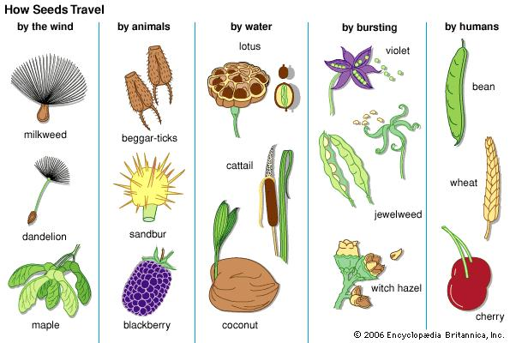
Why Fruits???
The shape of fruit tells you a lot about how it is spread.

Slide 16
Flower Dissection Lab
Fold a piece of white computer paper into quarters.
Label each quarter with the following words:
Sepal
Petals
Stamen
Carpel/pistil
**Arrange the parts of the flower in the correct space. Provide brief explanation of function for each!**

Slide 17
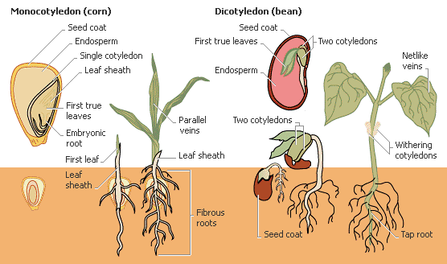
What Happens to the Seed?
Germination: early growth stage of plant from seed

Slide 18
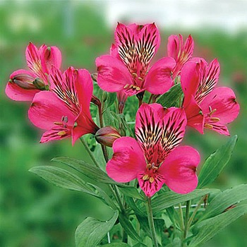
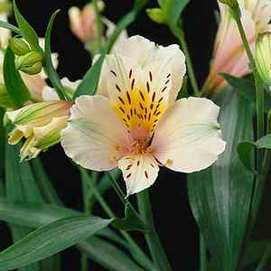
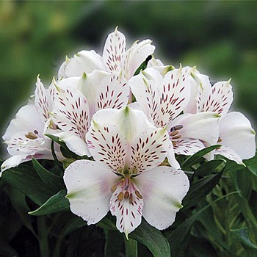
Flower Dissection- Alstroemeria!

Slide 19
Product A
Product B
Feature 1
Feature 2
Feature 3
Feature 1
Feature 2
Feature 3

