Slide 1
Roller Coaster Lab

Slide 2
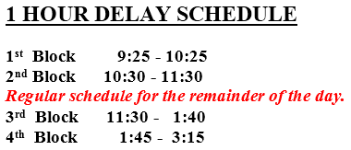
Bell Ringer
Agenda:
-Review Quiz
-Energy Notes
-Roller Coaster Notes
No Bell Ringer Today.
Please get a piece of paper on your desk so we can start our lab ASAP!☺

Slide 3
Transformation of Potential and Kinetic Energy
Please get a sheet of paper on your desk!

Slide 4
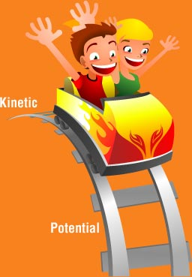
Gravitational Potential Energy (E_{g})
Gravitational potential energy (GPE)
the potential energy stored in an object when work is done on the object to elevate it against Earth’s gravity
E_{g} = mgh
m = mass in kilograms
h = height in meters
g = acceleration due to gravity (9.8 m/sec²)

Slide 5
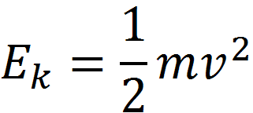
Kinetic Energy (E_{k})
Kinetic energy is the energy of motion
E_{k} = kinetic energy
m = mass in kilograms
v = velocity in m/sec

Slide 6
Roller Coaster Lab
Objectives:
To compare and analyze the E_{g} and E_{k} of a ball as it travels on a roller coaster.
Procedure:
Determine the E_{g} and E_{k} for 10 points along the roller coaster
Add the two energies together to determine the total energy in the system
Create ONE graph showing E_{g}, E_{k}, and total energy
INDIVIDUALLY TYPED Lab Report due
B4: 2/2/17
A1: 2/3/17

Slide 7
Roller Coaster Lab Report
Title:
Must clearly and accurately reflect the major emphasis of your experiment and prepare readers for the information you present. {Example: The effect of (independent variable) on (dependent variable).}
Data Collection and Processing:
Raw Data Table – all data collected
Data Processing –
Data table with calculated E_{g}, E_{k}, and total energy
ONE graph showing E_{g}, E_{k}, and total energy
Conclusion and Evaluation:
Conclusion: Discuss the results of your experiment. Discuss whether your data support or refute your hypothesis. Specifically refer to your graphs! Make sure to address the following questions:
What is the relationship between height and E_{g}? (as you increase one what happens to the other?)
What is the relationship between velocity and E_{k}? (as you increase one what happens to the other?)
What happens to E_{g} in relation to E_{k}? (as you increase one what happens to the other?)
Describe what happens to the total energy of the ball while it is traveling on the roller coaster.
Limitations of experimental design: how well did your experimental design help you answer your experimental question? What worked well and why? What didn’t work well and why? You could also discuss outliers here.
Suggestions for improvements: What would you do differently next time?

Slide 8
Roller Coaster Lab Information
Make sure the roller coaster is setup on the 7th hole from the bottom
Mass of the marble is .028 kg.
Diameter of the marble .019m
Choose 10 different points on the roller coaster to place the photo-gate timer

