Slide 1
Bell Ringer
Agenda:
-Bell Ringer
-Pos. vs. Neg Work Notes
-NASA video
-Work & NRG Notes
-Work & NRG wksht

Slide 2
Work, defined
Work can be done by you, as well as on you
Are you the pusher or the pushee
Work is a measure of expended energy
Work makes you tired
Machines make work easy (ramps, levers, etc.)
Apply less force over larger distance for same work

Slide 3
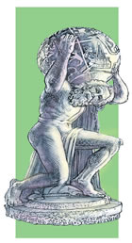
Atlas holds up the Earth
Is he doing work?

Slide 4
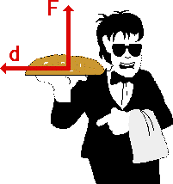
Garcon does work when he picks up the tray
but not while he
carries it around
the room

Slide 5
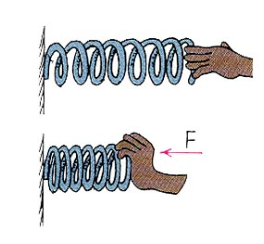
Work done by a spring
No movement
NO WORK
F
I compress the spring
I do positive work
Spring does negative work

Slide 6
Examples of WORK:
Backpack example
Lifting up from ground (F same direction as movement): +W
On back, starting to walk: +W
Walking at constant speed (flat ground): 0 W
Stopping (F opposite direction of movement AND kinetic energy decreasing): -W
Lowering back to ground: -W
OVERALL, did you do any work?
NO

Slide 7
Benchpress
Up: +W
Down: -W
No work done overall

Slide 8
ENERGY
Potential Energy: Ability to do work by virtue of position or condition.
Kinetic Energy: Ability to do work by virtue of motion. (Mass with velocity)
The Work-Energy Theorem: The work done by a resultant force is equal to the change in kinetic energy that it produces.

Slide 9
WORK AND ENERGY
If there is work being done in the system then there has to be a change in energy.
If there is no change in energy then no work has been done.

